Slide 1
Doctrine and Ethics-Compliant Autonomy using an Ontological Framework for Ethical Control of Unmanned Systems
Workshop on Ethical Computing, AAAI Spring Symposium 2022
Metrics for Measuring AI's Proficiency and Competency for Ethical Reasoning
Don Brutzman, Curtis Blais, Sinker Wu, Rich Markeloff and Carl Anderson
Naval Postgraduate School (NPS), Raytheon Corporation
22 March 2022
Notes:
Distribution is unrestricted. See Open-Source License for Ethical Control for details controlling this work. All ideas expressed remain the opinions of originators and do not represent the U.S. Department of Defense.

Slide 2
Acknowledgements
This paper was ably distilled by Carl Anderson based on a project report by Don Brutzman, Curt Blais and Sinker Wu. Collaborative work is performed under a cooperative Research and Development Agreement (CRADA) between NPS and Raytheon. No dissemination restrictions exist for any work on Ethical Control of Unmanned Systems.
We thank Robert B. McGhee, Duane T. Davis, colleagues and numerous students for fundamental contributions over the past 30 years.
We dedicate this paper to the memory of Dr. Richard Markeloff with thanks for his many guiding insights.

Slide 3
Abstract
Ensuring ethical robot behavior requires complex representations and methodologies designed to guarantee it. Our approach extends frameworks already used by the U.S. military to ensure human ethical and doctrinal behavior by human beings. These have built in advantages of being able to express complex plans and constraints, yet remaining intelligible to humans, a requirement for ethical responsibility and liability.
To extend the framework to machines, mission constructs are expressed using an Autonomous Vehicle Command Language (AVCL) expressing mission actions and outcomes that can readily be translated to runnable source code in several programming languages. Missions written in AVCL can be validated via translation to an RDF/OWL Mission Execution Ontology (MEO) supporting queried proofs of ethical correctness. MEO ensures that missions are both semantically valid and compliant with ethical constraints. These technologies implement a simulation, testing, and certification regime that can serve as a foundation for human authority over and trust in robots capable of lethal force.

Slide 4
Motivation and concepts
What are we talking about?

Slide 5
Military Challenges for Ethically Compliant Systems
We are working within a military context, but applicability seems broad.
Humans are qualified with legal, moral and command authority to carry out missions with potentially lethal (or indeed life-saving) force.
Human teams have well-defined community ethos and doctrine, with tactics, techniques and procedures (TTPs) for precise communication and distributed execution on a global scale.
Principles of International Humanitarian Law (IHL) and Laws of Armed Conflict (LOAC) are well understood by practitioners.
Perhaps not in legalistic terms, but absolutely understood in moral terms regarding whether mission directions are based on lawful orders.

Slide 6
People first – machines under human control
Only humans have authority, responsibility and accountability for actions with potential for lethal outcomes.
Includes responsibility for unmanned systems under their command
Guiding heuristics for designing new AI-enabled mission capabilities:
How do humans accomplish such goal tasks today?
How might unmanned systems accomplish similar tasks in future?
How can human commanders safely direct and supervise such systems, retaining moral and legal authority over operations?

Slide 7
Criterion: Predictability
Robot control and associated development practices must be sufficiently reliable to predict robot behavior in any situation.
Anything less is relinquishing authority and responsibility.
How do we measure that?
How do we repeatably measure that?
How to certify robots as competent to do what they are told, and not do what they are forbidden to do?

Slide 8
Criteria: Authority and Responsibility
Robot control must support ultimate (direct or indirect) control by qualified, well-informed humans over robot activities and outcomes.
Dull dirty dangerous: actions may occur in hazardous environments, with intermittent communications, at lengthy distances and durations.
Because only human beings are accountable for moral responsibility, any robotic failures must be traceable back to a specific human entity (programmers, manufacturers, policy, operators, leadership, others).
Like human failures, everything subject to strict oversight and review

Slide 9
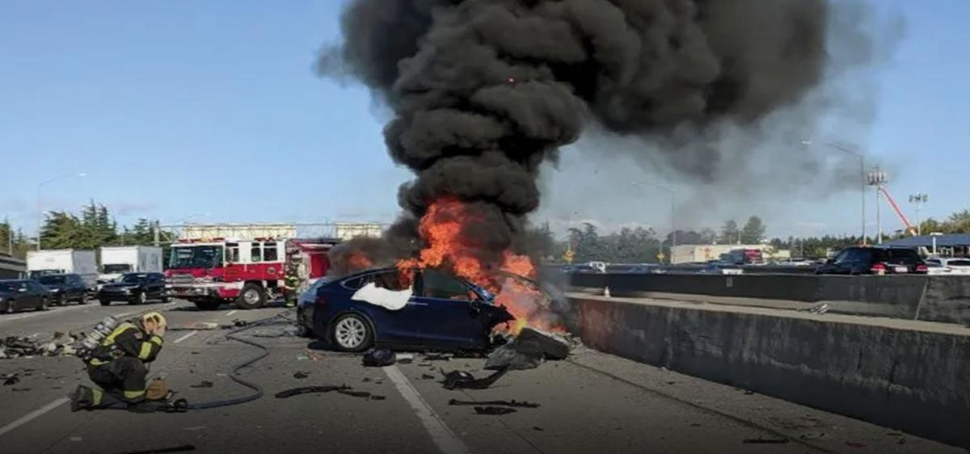
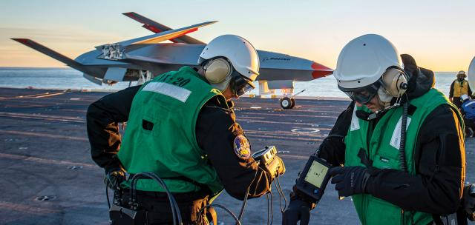
Artificial Intelligence: Too Fragile to Fight?
U.S. Naval Institute (USNI) PROCEEDINGS
Automation—including AI—has persistent, critical vulnerabilities that must be thoroughly understood and adequately addressed if defense applications are to remain resilient and effective.
Commander Edgar Jatho USN and Joshua A. Kroll, NPS
February 2022, Vol. 148/2/1,428
Machine learning (ML) and especially modern “deep learning” methods—the very methods driving the advances that make AI an important focus area today—are distinctly vulnerable to deception and perturbation.³ Often, human-machine teaming is thought to be the solution to these issues, but such teaming itself is fraught and unexpectedly fragile in persistently problematic and counterintuitive ways
https://www.usni.org/magazines/proceedings/2022/february/artificial-intelligence-too-fragile-fight
Fatal crash of self-driving car, California 2018.

Slide 10
Criteria: Liability, Accountability, Culpability…
Liability assignment (whether legal or moral) requires that parties involved in robotic development and employment can reasonably foresee outcomes for which they are responsible.
No really. This is due diligence. If in doubt, consider alternative…
Currently hard to establish thresholds for acceptance, metrics needed.
Riddle: Shiny new robot arrives, very expensive and powerful, guidance says “push big red AI button to operate.” What to call that?
Riddle: Autonomous passenger vehicle confronted by trolley problem, must turn right/left or slam ahead or slam behind, fatalities likely.
What do we call that decision point in the software?

Slide 11
Mission-oriented approach, common across all platforms
Ethical operations require trust at all levels, up down left right

Slide 12
Foundational concept: Rational Behavior Model
Three-level architectures provide good division of abstractions that often maps well to division of responsibility for human activities.
We often see three-level architectures in all manner of robot designs
How to exploit similarities?
Treat robots as subordinates
within the same framework.
If not competent and trusted, then human orders are
out of scope and unsound.

Slide 13
Foundational concept: communications are key
Human military actions are governed by formal mission orders
Well-defined lexicons with varying terms, consistent semantics
Structured orders follow guidance, who what when where how why
Effective across diverse communities, countries (e.g. NATO procedures)
Both operators and systems require coherent command language, otherwise orders are syntactically invalid or semantically confounded.
Syntactic validation with schema: is mission tasking precisely defined?
Semantic validation with ontology: is mission coherent, consistent, complete? Does it meet guidance? Does it avoid contradictions/omissions?
In combination: better AI support for human commanders, also testable.

Slide 14
Ternary goal logic: success, failure, exception
Conduct of mission orders can be expressed as series of goals connected as tree describing how to follow completion of each goal.
Original basis was binary decision tree. Ternary approach is more concise.

Slide 15
Autonomous Vehicle Command Language (AVCL)
AVCL is a command and control language for humans supervising autonomous unmanned vehicles.
Clarity arises from close correspondence to human naval terminology.
Structured vocabulary defining terms and relationships for mission planning, execution, conduct, recording and replay across diverse robot types.
Common-ground XML representations for
Mission agenda plans, mission scripts, and post-mission recorded telemetry results.
Future work: defining unit tests and expected results for verification and validation.
Operators have single archivable, validatable format for robot tasking, results
directly convertible to and from a wide variety of different robot command languages.
Mission Tasking
https://savage.nps.edu/Savage/AuvWorkbench/AVCL/AVCL.html

Slide 16
Example AVCL mission agenda, as pseudo-code XML
<?xml version="1.0" encoding="UTF-8"?>
<UUVMission>
<GoalSet>
<Goal area=”A” id=”goal1”>
<Search nextOnSuccess=”goal2” nextOnFailure=”goal3”/>
</Goal>
<Goal area=”A” id=”goal2”>
<SampleEnvironment nextOnSuccess=”goal3”
nextOnFailure=”recover”/>
</Goal>
<Goal area=”B” id=”goal3”>
<Search nextOnSuccess=”goal4” nextOnFailure=”goal4”/>
</Goal>
<Goal area=”C” id=”goal4”>
<Rendezvous nextOnSuccess=”recover” nextOnFailure=”recover”/>
</Goal>
<Goal area=”recoveryPosition” id=”recover”>
<Transit nextOnSuccess=”missionComplete” nextOnFailure=”missionAbort”/>
</Goal>
</GoalSet>
</UUVMission>
AVCL is readable by human or robot,
captures logic of mission tasking
XML ensures syntactically correct, well-defined, numerically valid
Needed: semantic representation
to check ethical, logical consistency

Slide 17
AVCL mission goals vocabulary (Davis 2015)
AVCL mission goals | Define | Used | Definition
Attack | partial | √ | To conduct a type of offensive action characterized by employment of firepower and maneuver to close with and destroy an enemy.
Decontaminate | √ |  | To provide purification making an area safe by absorbing, destroying, neutralizing, making harmless, or removing chemical, biological, or nuclear contamination.
Demolish | √ |  | To destroy structures, facilities, or material by any available means.
IlluminateArea | √ |  | To provide locale lighting by searchlight or pyrotechnics.
Jam | √ |  | To deliberately radiate, re-radiate or reflect electromagnetic energy with the object of impairing the use of electronic devices or systems.
MarkTarget | √ | √ | To make visible (by the use of light, infrared, laser, smoke, etc.) of an object in order to allow its identification by another object.
MonitorTransmissions | √ | √ | To conduct electronic warfare support operations with a view to searching, locating, recording and analyzing radiated electromagnetic energy.
Patrol | √ | √ | To gather information or carry out a security mission.
Rendezvous | √ | Partial | Achieve a meeting at a specified time and place.
Reposition | √ | √ | To change position from one location to another.
SampleEnvironment | Partial | √ | Collect environmental samples for testing for chemical compounds, biological creatures, or nuclear hazards.
Search | √ | √ | To look for lost or unlocated objects or persons.
More
Goal Types Foreseen

Slide 18
Mission Execution Ontology (MEO) for Ethical Control of Unmanned Systems in Surrogate Scenarios
Summary of relationships
Autonomous Vehicle Command Language (AVCL) for Missions.
Declarative XML, years of NPS research.
Multiple Mission Representations.
Imperative commands (orders/waypoints/etc.).
Declarative commands (mission goals).
Mission results (order log, telemetry etc.).
Mission metadata for parameters, settings.
Lisp and Prolog examples (Bob McGhee, NPS).
Autonomous Unmanned Vehicle (AUV) Workbench Simulation and Visualization Support
Recently restored, debug testing commenced.
AVCL 2.1 is prior published version, centered on syntactic validation, solo robot operations.
AVCL 3.0 is new working version for testing range of multi-participant missions.
Mission Execution Ontology (MEO) for Semantic Validation
Semantic Web framework of rules, relationships for ethical validation.
Initial examples in IEEE JOE paper.
Retested using current Protégé, Jena tools.
Sailor Overboard and Other Missions
Hand-crafted triples using Turtle syntax.
Beginning to build unit testing framework.
Confirming correlation of AVCL information model to existing MEO ontology.
Automatic conversion of AVCL missions to match, thus accelerating multiple-mission testing on diverse systems.
Visualization, reporting via AUV Workbench can aid understanding, mission planning and further progress.

Slide 19
Description Logic (DL) Rules provide basis for Mission Execution Ontology (MEO)
Rules | Description Logic Equations | Plain-language description
M = Mission Rules
M1 | Mission ⊑ ∀startsWith.Goal ⊓ =1startsWith.Goal | A Mission can only start with a Goal and must start with exactly one Goal
M2 | Mission ⊑ ∀includes.Goal ⊓ ≥1includes.Goal | A Mission can only include Goals and must include one of more Goals
M3 | Mission ⊑ ∀hasConstraint.Constraint | A Mission can only be constrained by Constraints
M4 | startsWith ⊑ includes | A Mission must include the Goal that it starts with
M5 | Mission ⊑ ∀performableBy.Vehicle | A Mission can only be performed by a Vehicle
M6 | Cannot be expressed in DL | A Mission cannot be performable by a Vehicle unless that Vehicle has the ability to identify all Constraints associated with that mission
M7 | Cannot be expressed in DL | A Mission cannot be performable by a Vehicle unless that Vehicle has the capability to accomplish all Goals included in that Mission
Excerpted from full
Mission Execution Ontology Decision Logic Tables
Original author: Duane Davis
Model updated by Curtis Blais in collaboration with Raytheon engineers through NPS-Raytheon CRADA

Slide 20
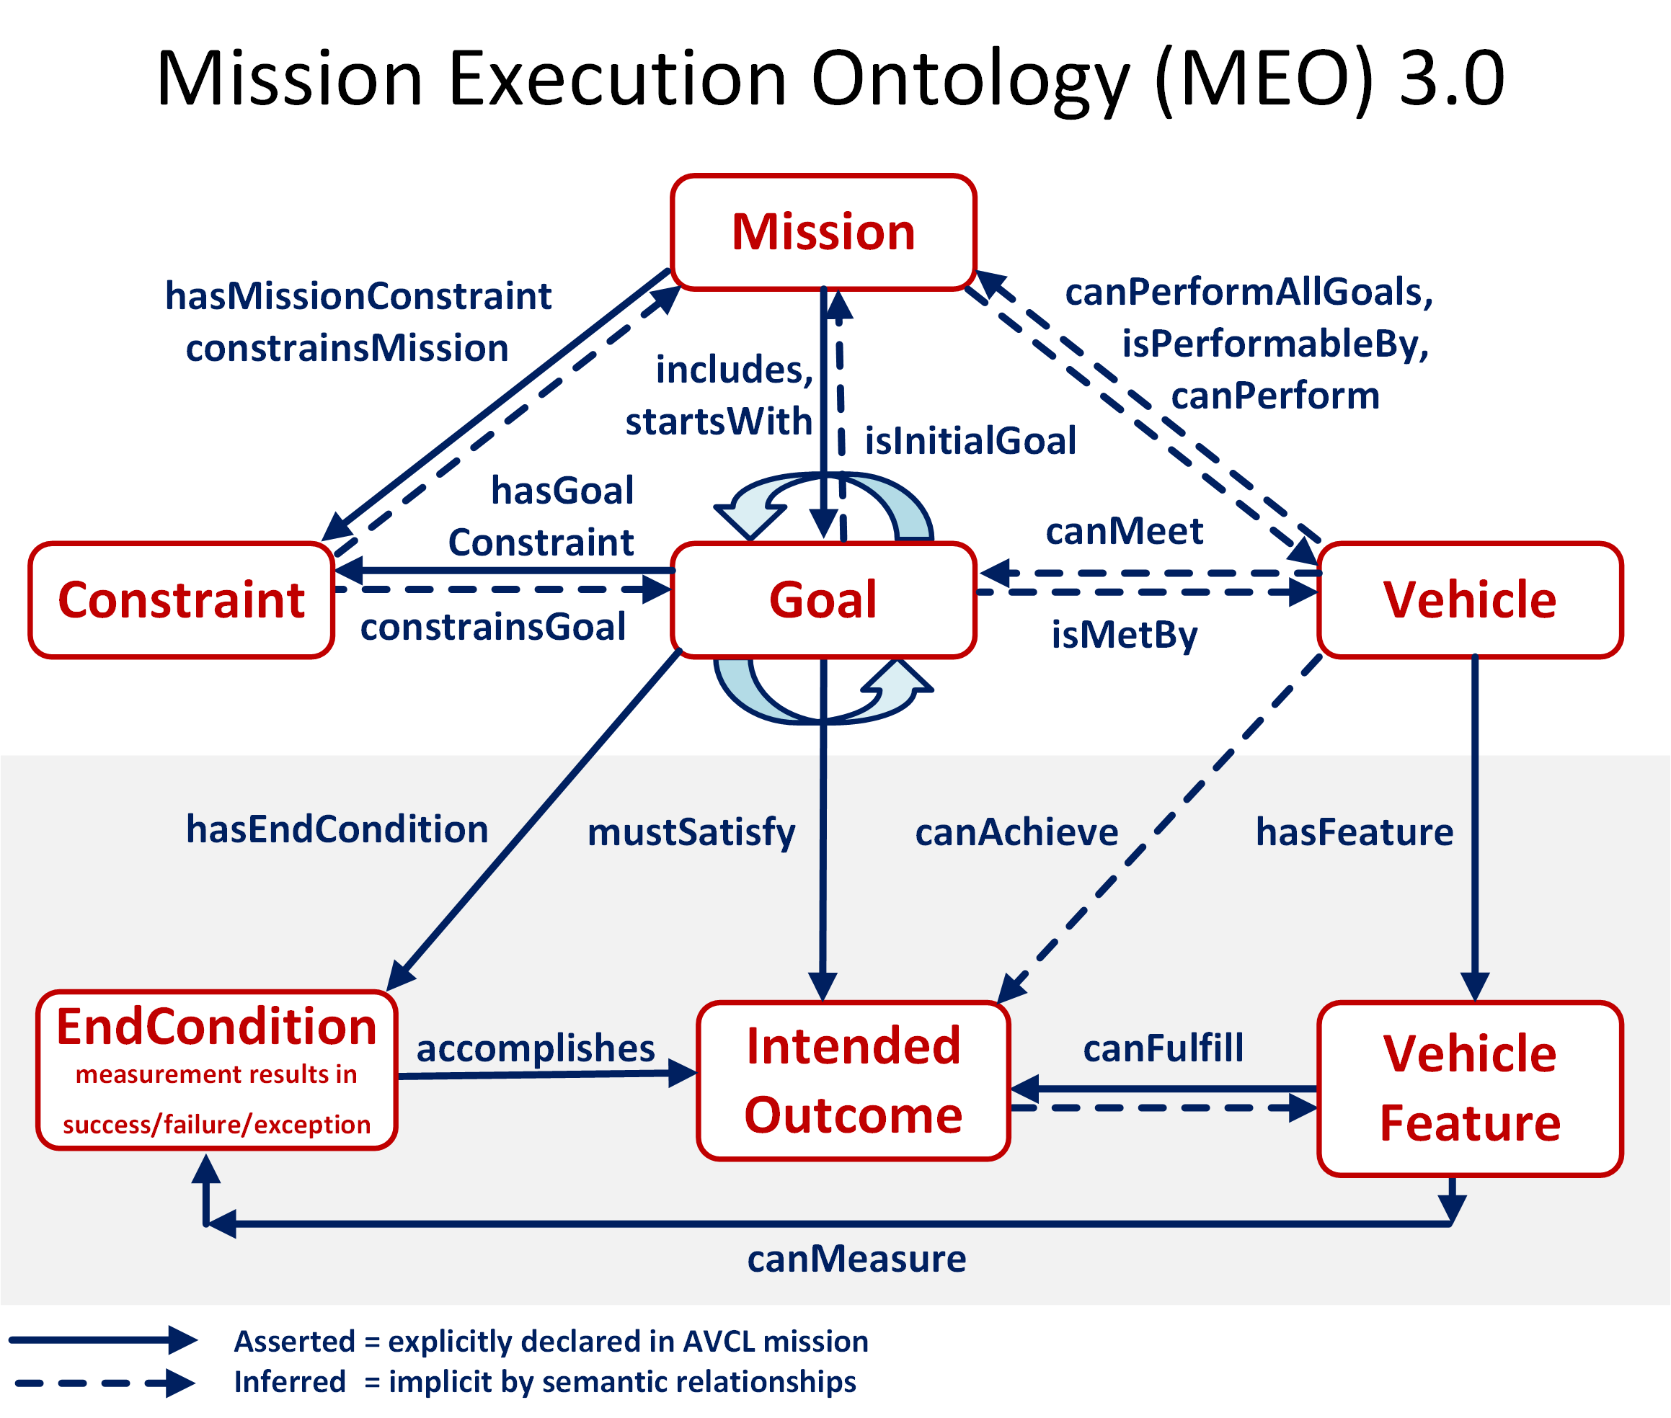

Slide 21
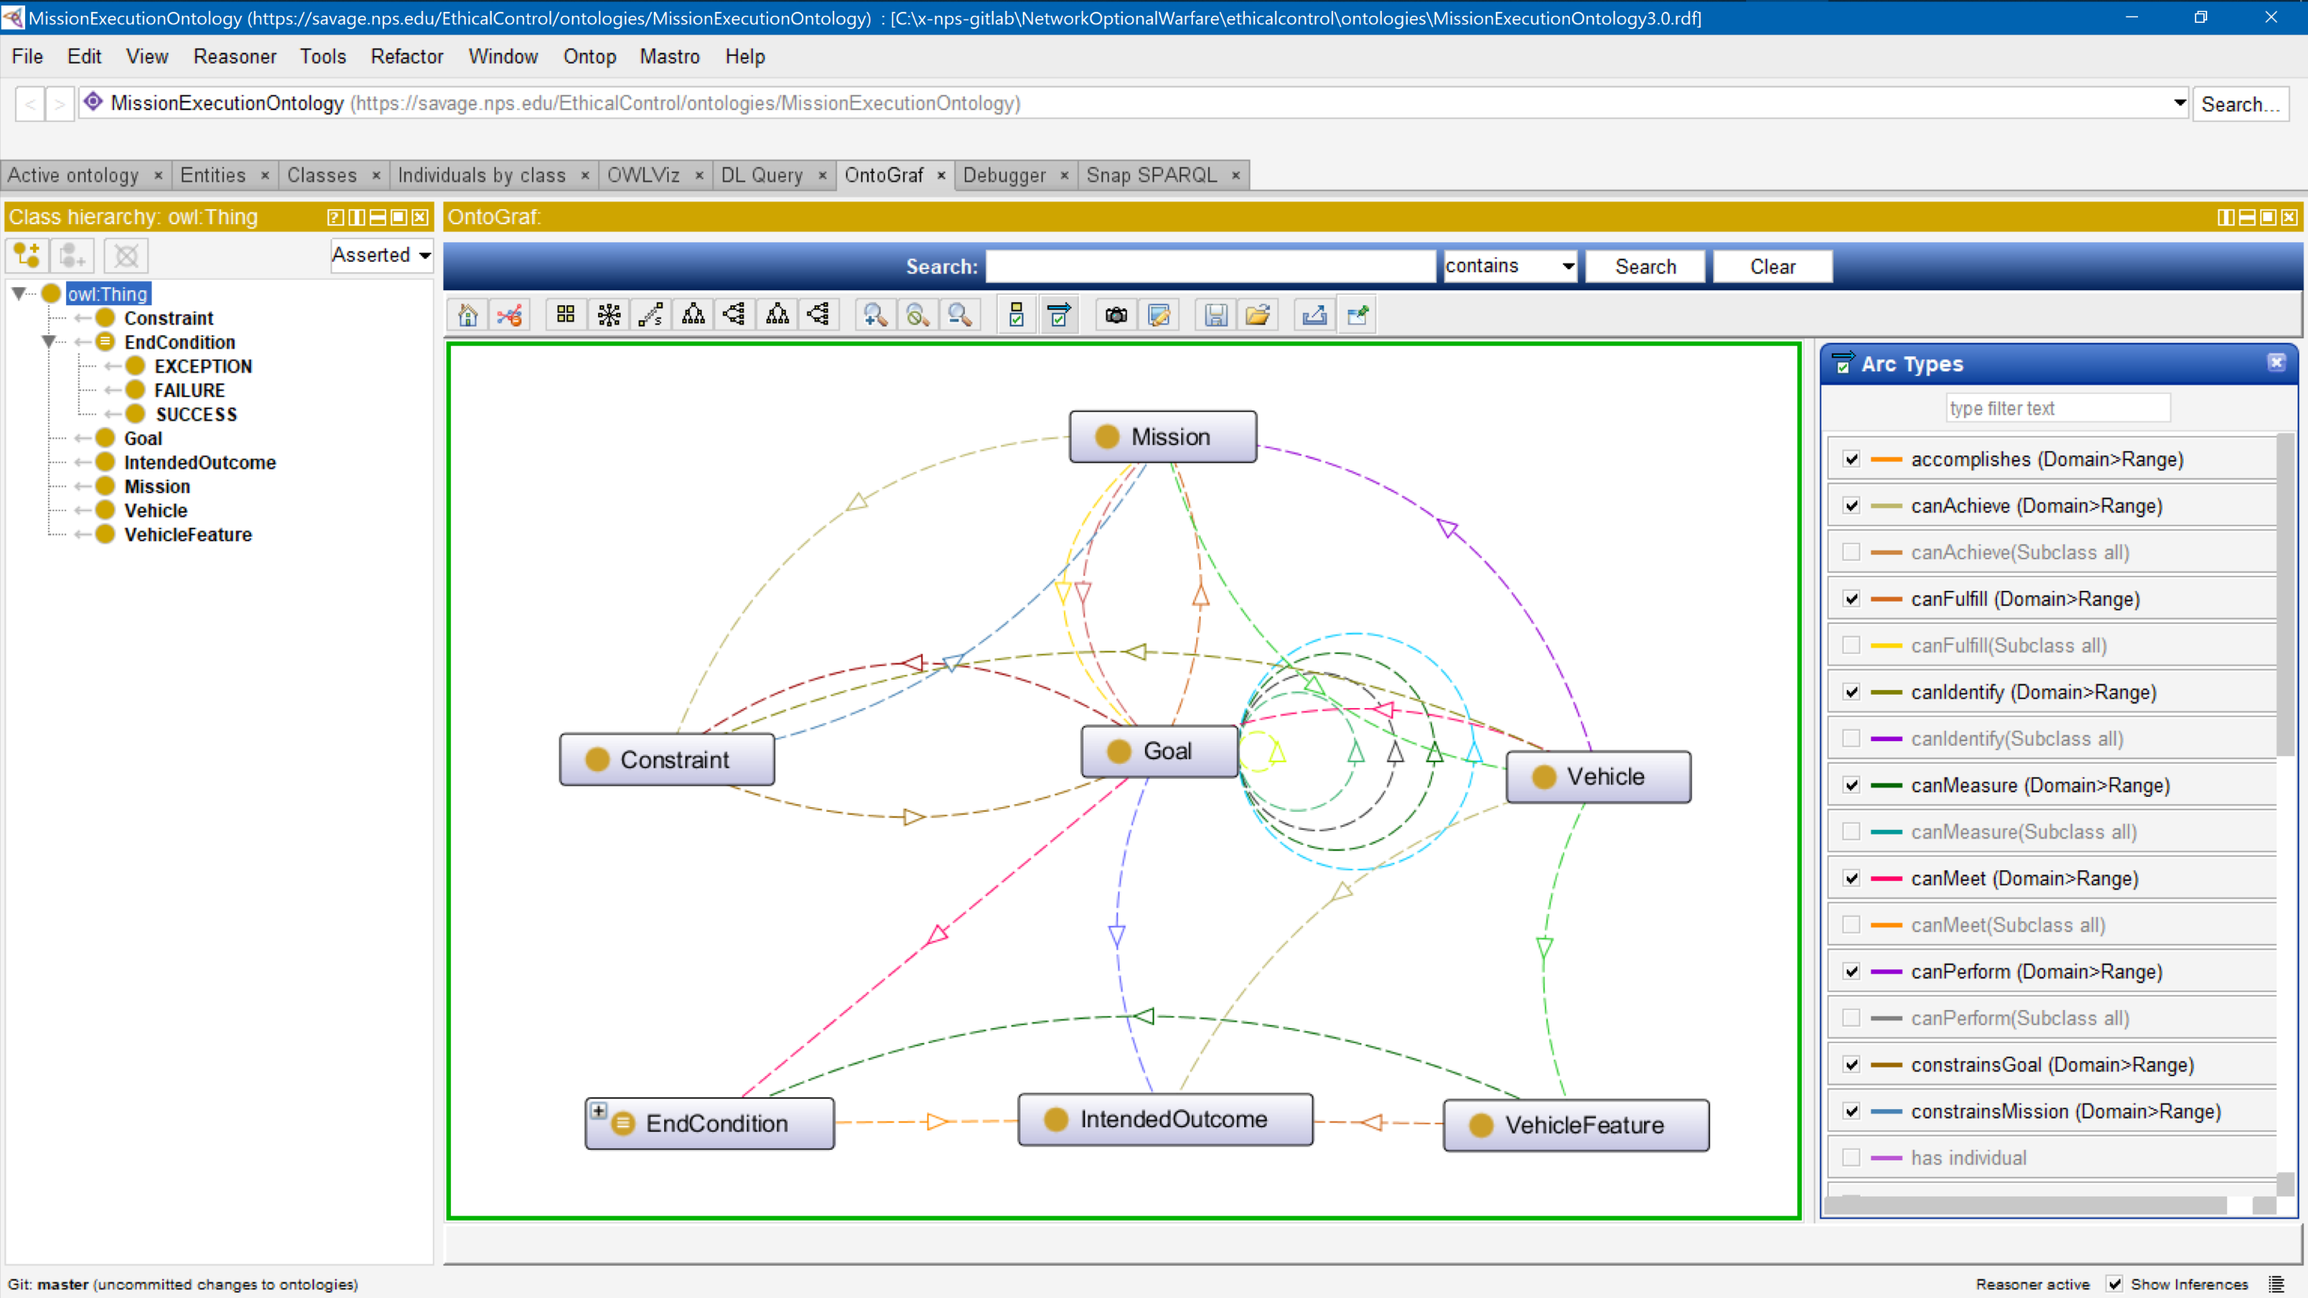
Mission Execution Ontology (MEO) source implemented, tested using Protégé tool

Slide 22
Variations on a theme: Sailor Overboard
Every sailor on board knows what to do. Will our robots perform well with others?
Buckle your safety belts, we will move fast!

Slide 23
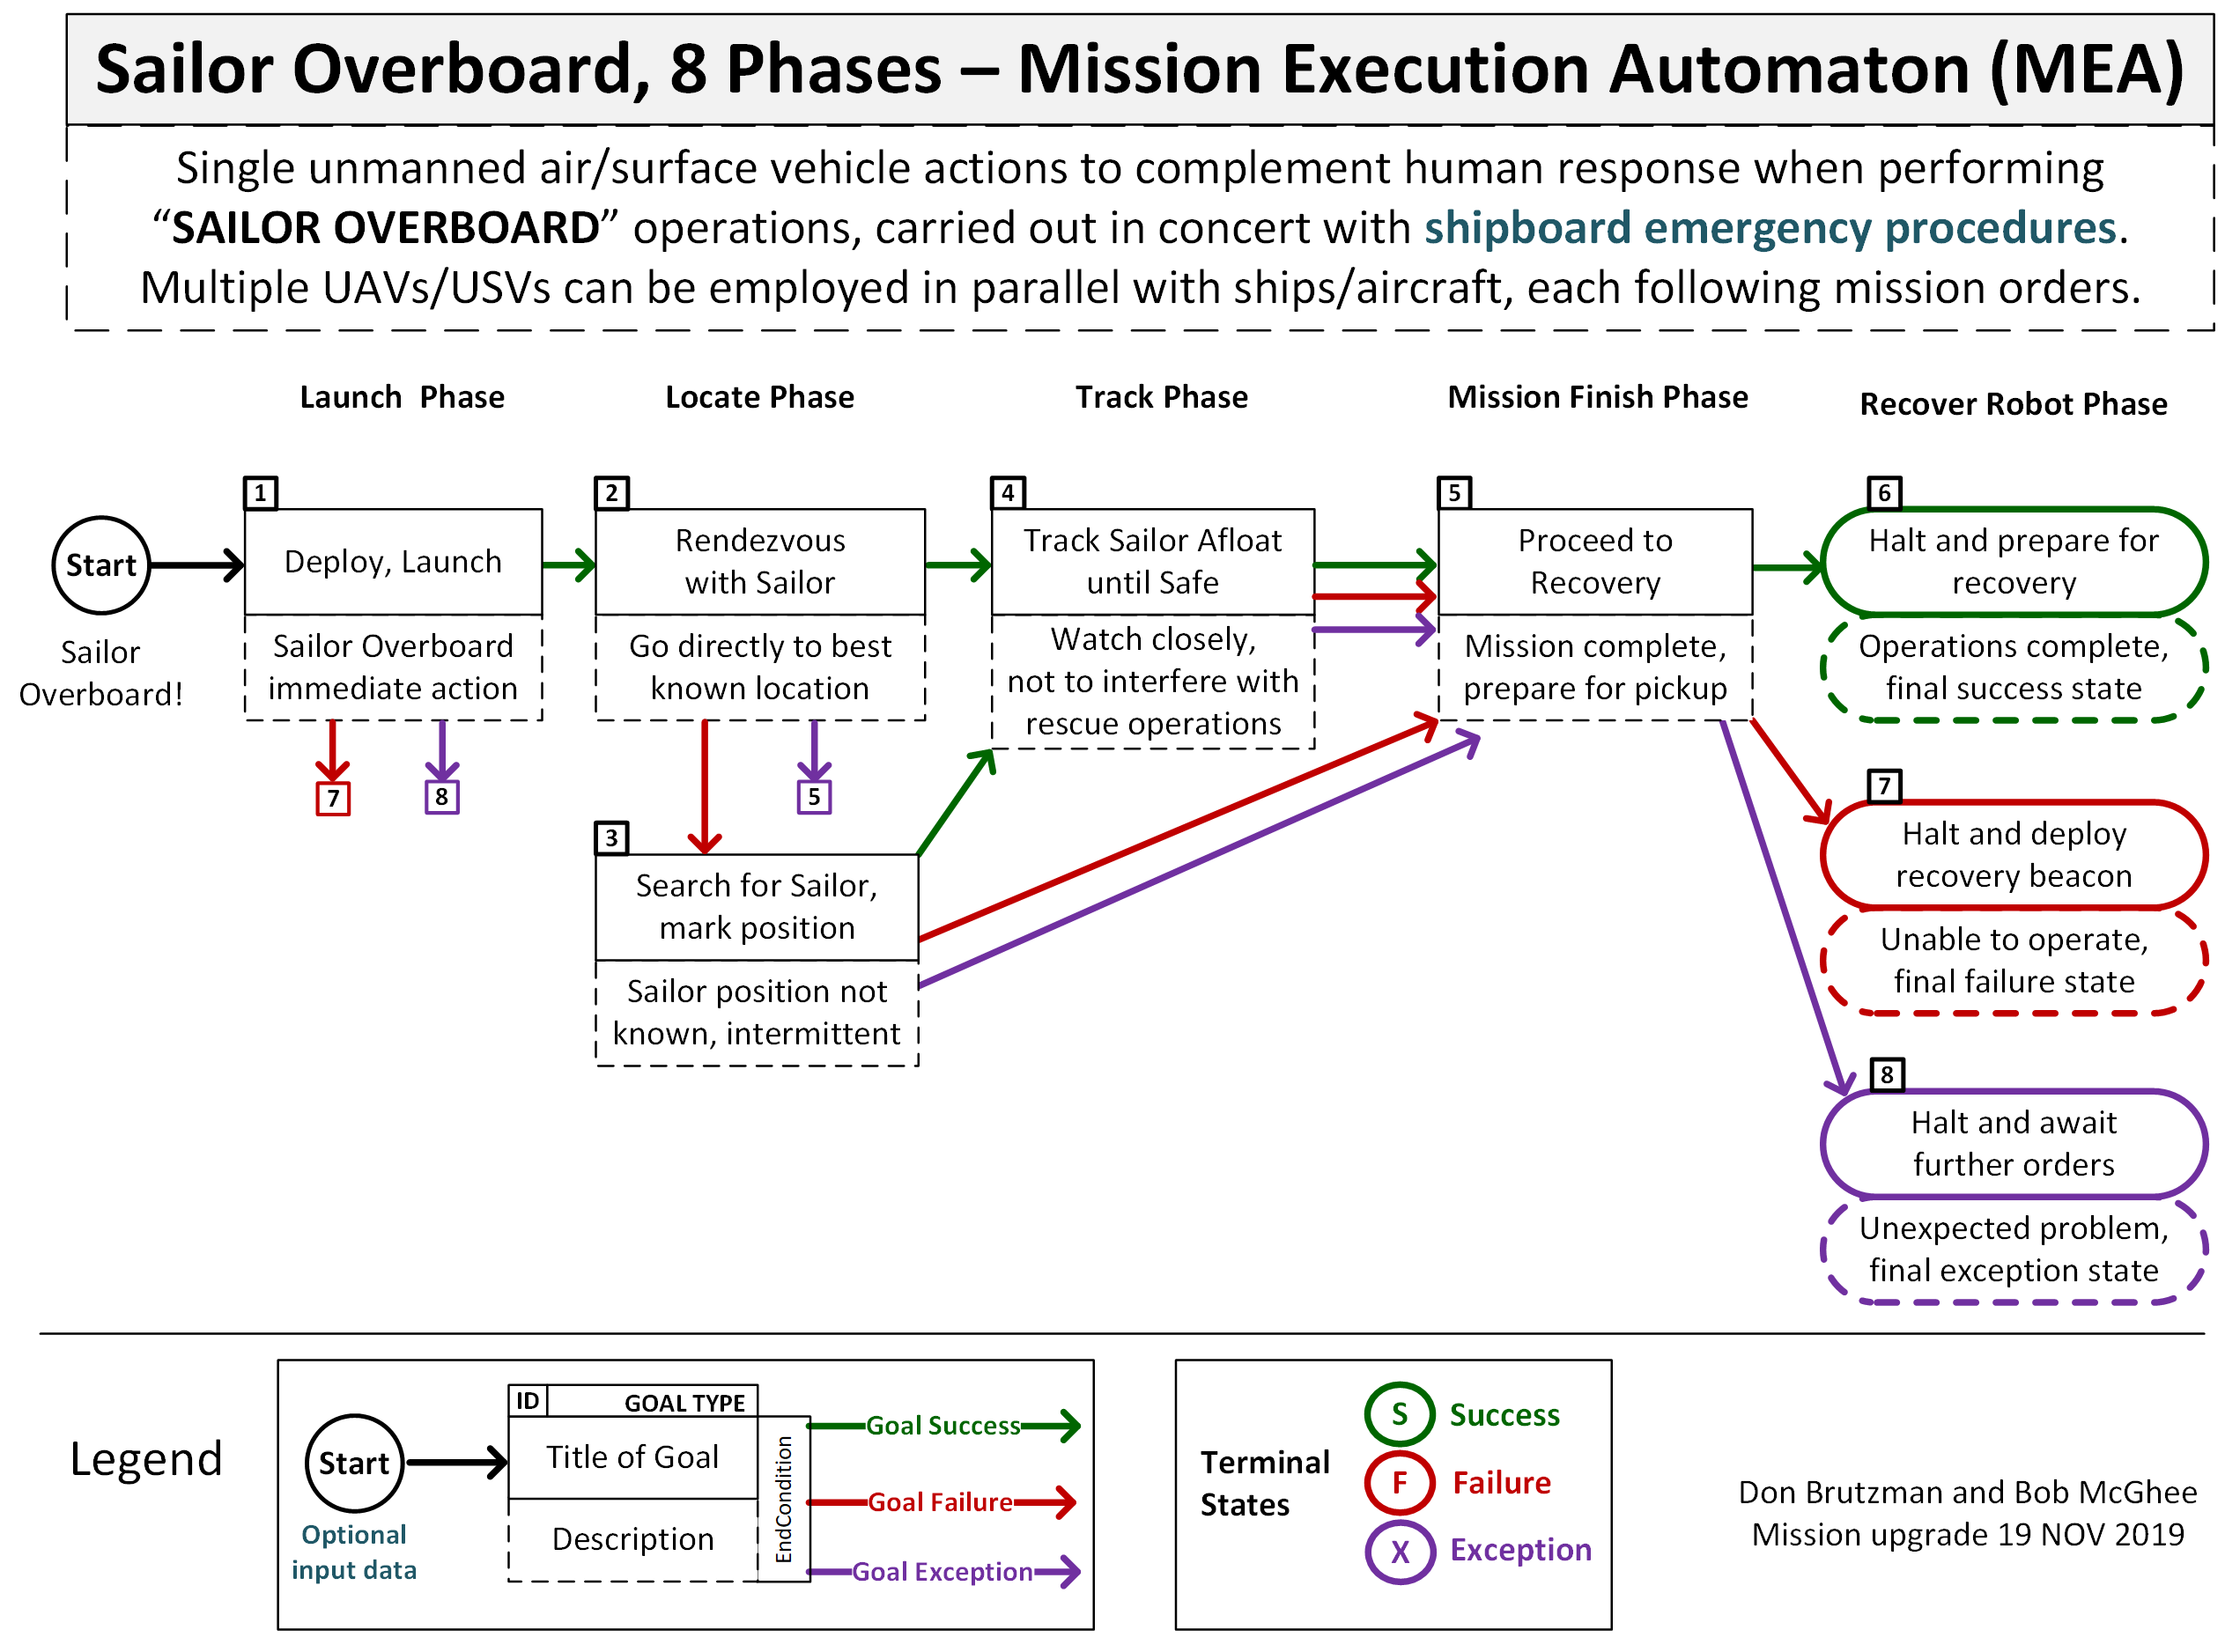
Sailor overboard mission diagram

Slide 24
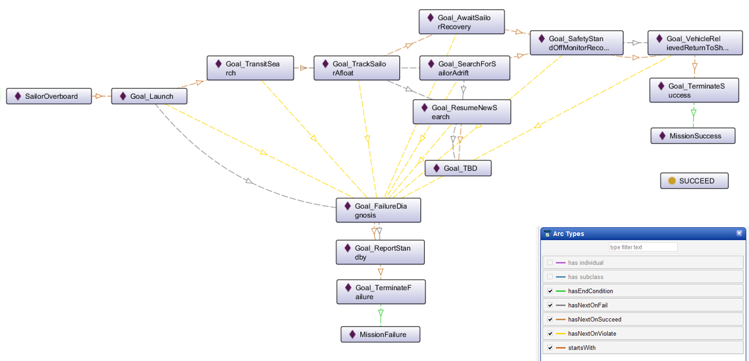
Ethical Control of Unmanned Systems in a Surrogate Scenario: Sailor Overboard Mission defined using the MEO Ontology
Current work is designing,
building and testing a set
of exemplar missions

Slide 25
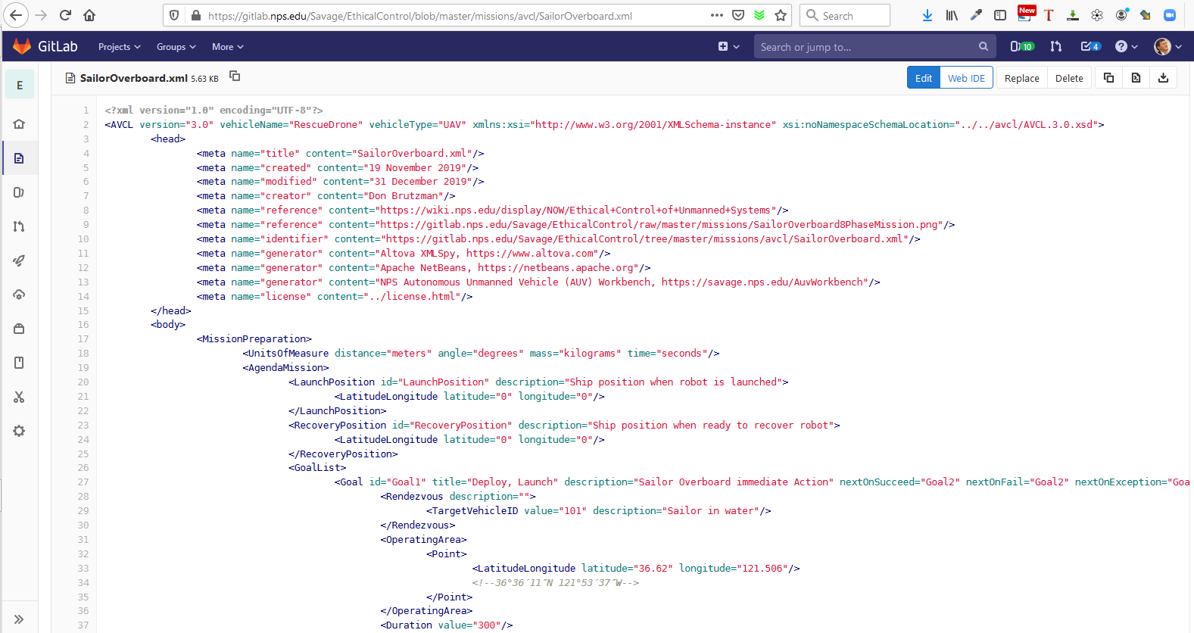
SailorOverboard.xml in gitlab.nps.edu version control

Slide 26
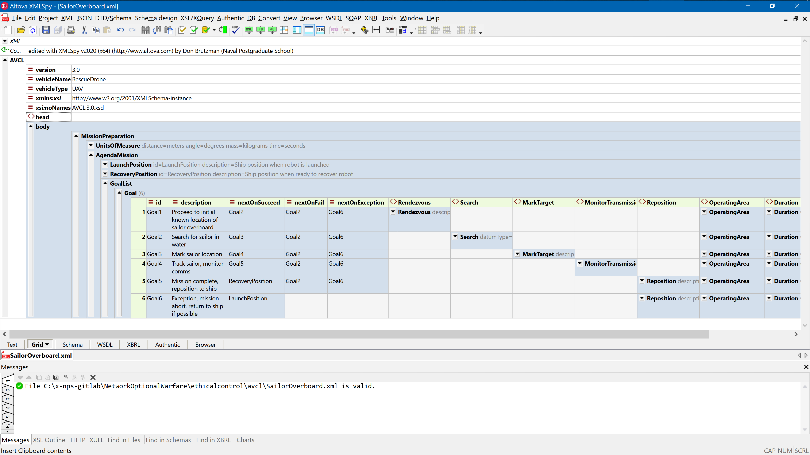
Sailor overboard mission orders AVCL

Slide 27
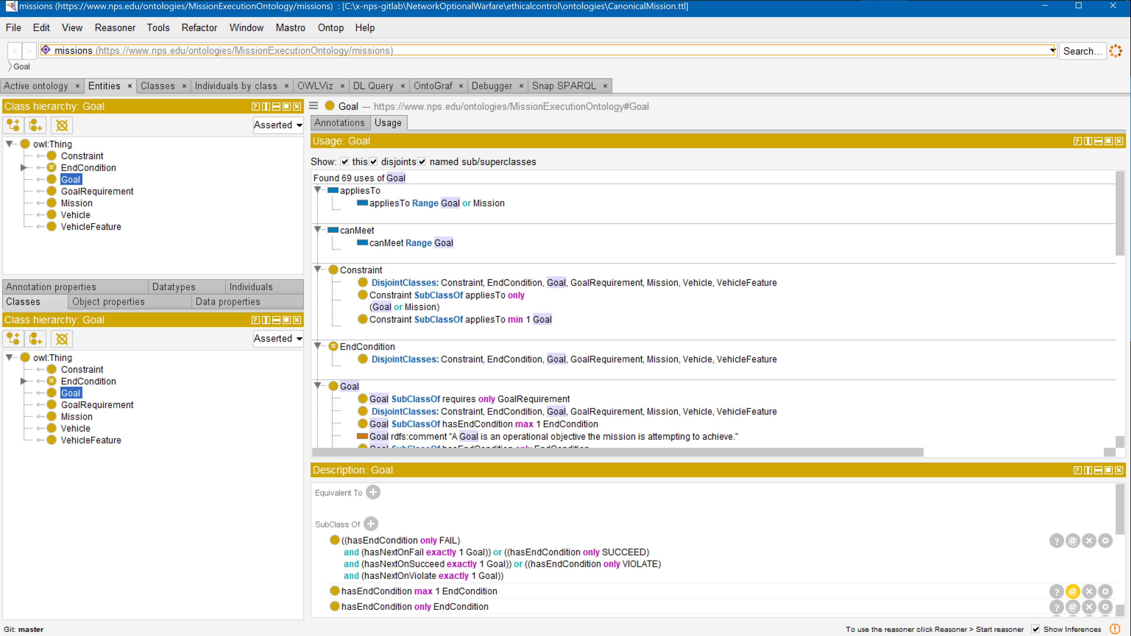
Sailor overboard mission .ttl Turtle

Slide 28
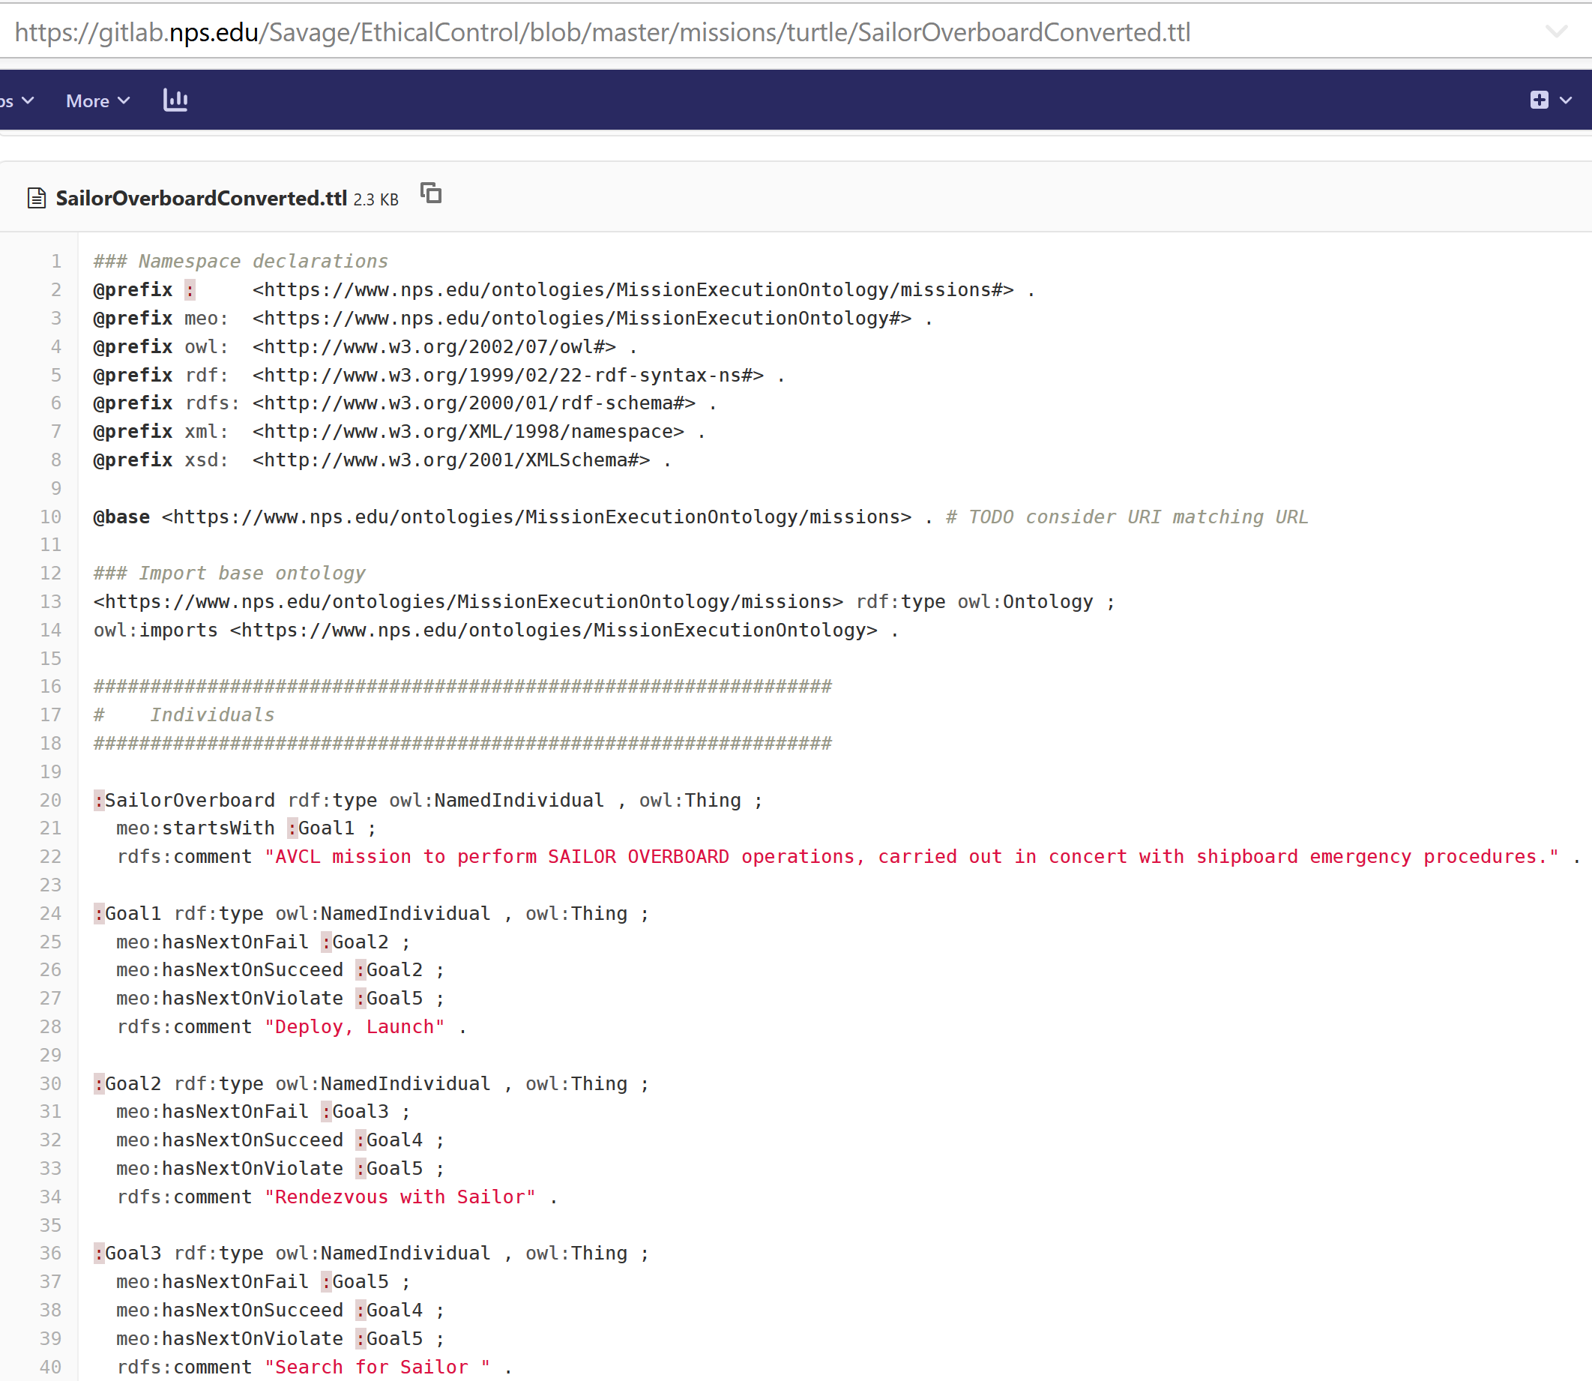
SailorOverboardConverted.ttl Turtle excerpt autogenerated in gitlab.nps.edu version control

Slide 29
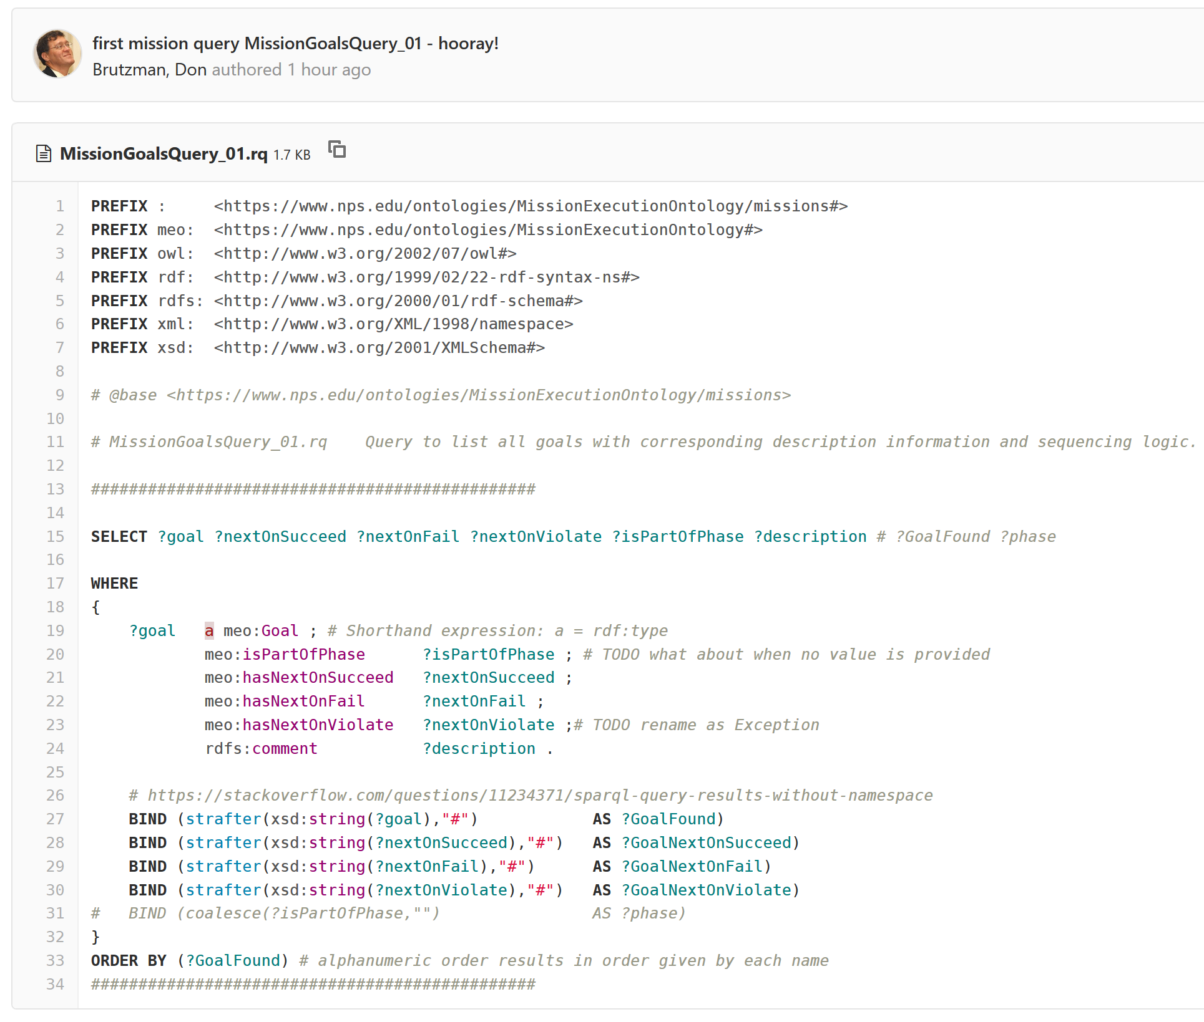
SPARQL mission query MissionQuery_01_GoalBranches.rq

Slide 30
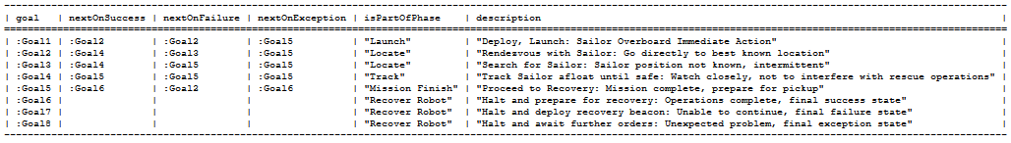
SPARQL query response SailorOverboardConverted. MissionQuery_01_GoalBranches.rq.txt
SPARQL query response
SailorOverboardConverted. MissionQuery_02_InitialGoal.rq.txt
TODO: SHACL queries

Slide 31
Enablers for broad outcomes
Military perspective is subset of broader shared global challenges
Imperatives are fundamentally important, thus any solutions must scale up

Slide 32
Semantic Web: Knowledge Representation at Web Scale
Architects of the World Wide Web have laid out a layered set of standards to achieve the Semantic Web vision: “not a separate Web but an extension of the current one, in which information is given well-defined meaning, better enabling computers and people to work in cooperation” (Berners-Lee et al. 2001)
Ultimate goal: achieve a scalable trusted information infrastructure where humans and software interact meaningfully, in a repeatable environment where expectations of quality and integrity are met.
Scalable approach indicates that single (ship + robot) solutions have potential to grow and encompass many simultaneous systems, thus improved data sharing, mission deconfliction, coordinated operations

Slide 33
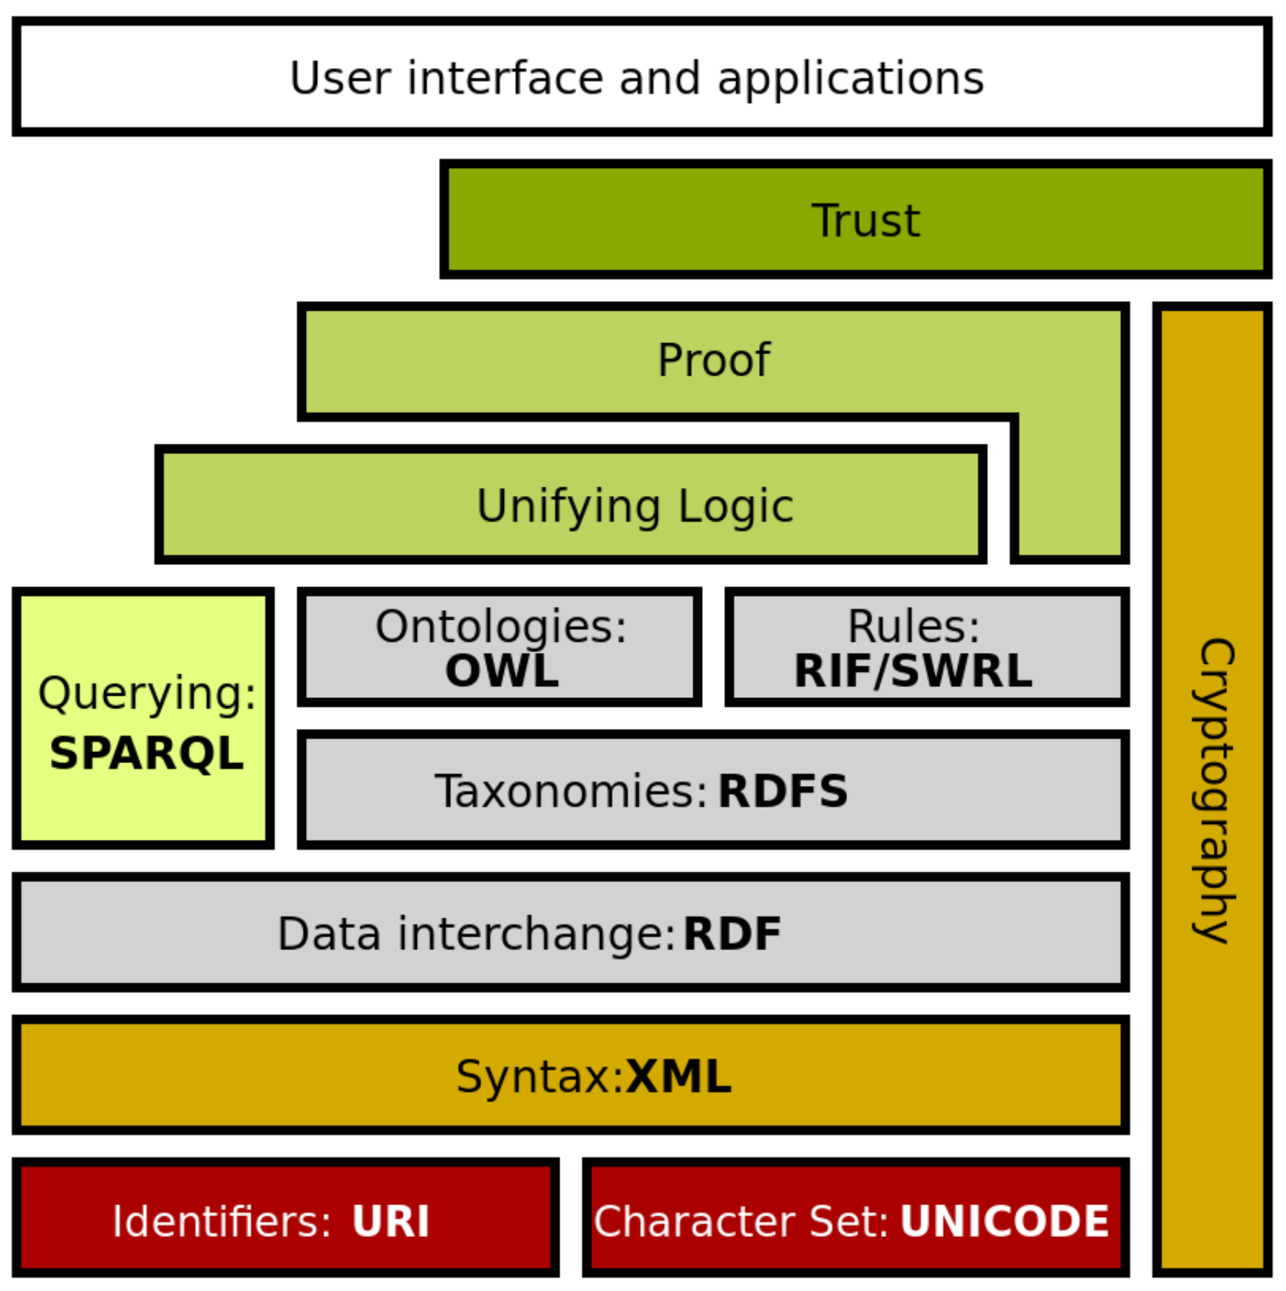
Semantic Web Stack
Extends larger Web architecture
All of these data languages are approved W3C standards
Proof and unifying logic are mathematically well defined
Trusting derived (composed) statements arises from
Encryption + digital signature confirms trusted data sources
Formal logic is basis for deriving new information
Wikipedia: Semantic Web Stack
Of note: this project is exercising every layer of Semantic Web stack.

Slide 34

IEEE P7000-series Standards Projects https://ethicsinaction.ieee.org
P7000 Model Process for Addressing Ethical Concerns during System Design
P7001 Transparency of Autonomous Systems
P7002 Data Privacy Process
P7003 Algorithmic Bias Considerations
P7004 Standard on Child and Student Data Governance
P7005 Standard on Employee Data Governance
P7006 Standard on Personal Data AI Agent Working Group
P7007 Ontological Standard for Ethically driven Robotics and Automation Systems
P7008 Standard for Ethically Driven Nudging for Robotic, Intelligent and Autonomous Systems
P7009 Standard for Fail-Safe Design of Autonomous, Semi-Autonomous Systems
P7010 Well-being metrics Standard for Ethical Artificial Intelligence and Autonomous Systems
P7011 Stadard for the Porcess of Identifying and Rating the Trustworthiness of News Sources
P7012 Standard for Machine Readable Personal Privacy Terms
P7014 Standard for Ethical Considerations in Emulated Empathy in Autonomous and Intelligent Systems

Slide 35

IEEE Standards Project P7007 for Ontological Standard for Ethically driven Robotics and Automation Systems
IEEE Global Initiative on Ethics of Autonomous and Intelligent Systems.
https://ethicsinaction.ieee.org includes large document providing broad rationale.
Includes 15 separate working groups in IEEE Standards Association (IEEE-SA).
Relevant group: P7007, Ethically driven Robotics and Automation Systems.
“IEEE P7007 Standards Project for Ontological Standard for Ethically driven Robotics and Automation Systems establishes a set of ontologies with different abstraction levels that contain concepts, definitions and axioms that are necessary to establish ethically driven methodologies for the design of Robots and Automation Systems.”
http://standards.ieee.org/develop/project/7007.html
Must be IEEE member, observe patent-policy requirements to participate in working group.
“Not the intent to specify required ethical behaviors, but rather to formalize a vocabulary of terms, concepts, and relationships that can be used to enable unambiguous discussion among […] communities regarding what it means for autonomous systems to exhibit ethical behaviors.”
Excellent forum with rich references, worth observation and participation.
Active work: align several Ethical Control terms, concepts, use cases with P7007.
Published
November 2021!

Slide 36
How can we measure all that?
Metrics, and testing methodology, are essential and perhaps sharable

Slide 37
Where Navy needs to go next…
Massive testing of unmanned hardware + software ability to follow both orders and constraints in physically realistic virtual environments: TestDevOps for learning-improvement cycles.
Influence and impact operations: certify real-world capabilities via field experimentation (FX), confirmed by Big Data analysis, defense test range exercises, wargames and theses.
Human warfighters and mission commanders (not just engineers) review and approve unmanned systems as… qualified.
New normal will be human + machine teaming together; future must mainstream all capabilities in acquisition and deployment.
Welcome to the future – the horizon is here!

Slide 38
Workshop day 3 lookahead: discussion invitation
We will discuss Meaningful Metrics for Demonstrating Ethical Supervision of Unmanned Systems, showing design framework based on
“How do you measure that?” as critical question, our problem domain requires mission-oriented testing repeatably and indefinitely
Live-virtual-constructive (LVC) TestDevOps for spiral improvement
We are listening closely and studying each of your contributions… thanks!
Your inputs are welcome on these cross-cutting workshop themes.

Slide 39
Synopsis: Ethical Control of Unmanned Systems
Project Motivation: ethically constrained control of unmanned systems and robot missions by human supervisors and warfighters.
Precept: well-structured mission orders can be syntactically and semantically validated to give human commanders confidence that offboard systems
will do what they are told to do, and further
will not do what they are forbidden to do.
Project Goal: apply Semantic Web ontology to scenario goals and constraints for logical validation that human-approved mission orders for robots are semantically coherent, precise, unambiguous, and without internal contradictions.
Long-term Objective: demonstrate that no technological limitations exist that prevent applying the same kind of ethical constraints on robots and unmanned vehicles that already apply to human beings.
How? Testing testing testing: simulation, virtual environments, analytics, field experiments, real-world analytics, new normal...
Paraphrase: can qualified robots correctly follow human orders?

Slide 40
Contact
Don Brutzman
brutzman@nps.edu
http://faculty.nps.edu/brutzman
Code USW/Br, Naval Postgraduate School
Monterey California 93943-5000 USA
1.831.656.2149 work
1.831.402.4809 cell
Notes:
Questions and feedback are always welcome. Thanks for considering the possibilities.

Slide 41
Contact
Curt Blais
clblais@nps.edu
https://nps.edu/faculty-profiles/-/cv/clblais
Code MV/Bl, Naval Postgraduate School
Monterey California 93943-5000 USA
1.831.656.3215 work
Notes:
Questions and feedback are always welcome. Thanks for considering the possibilities.

